Slide 1
ANN-Based Road Accident Hotspot Prediction
Project-Based Learning Report | CSL0606 – Deep Learning
SDG 3 (Good Health) & SDG 11 (Sustainable Cities)
Data Engineer
Model Developer
Optimizer & Reporter
Sumit Sharma
Anuj Pratap Singh
Amrit Sharma
BETN1AI23023
BETN1AI23048
BETN1AI23024
ITM University Gwalior
ITM University Gwalior
ITM University Gwalior
Guide: Dr. Sanjay Jain, Professor | Dept. of CSA, ITM University Gwalior

Slide 2
Agenda
2 / 14
01
Problem Statement & SDG Alignment
06
Model Development & Implementation
02
Literature Review
07
Results & Performance Analysis
03
Dataset Description
08
Innovation & IEEE Alignment
04
Data Preprocessing & Feature Engineering
09
Conclusion & Future Scope
05
Proposed System Architecture
CSL0606 – Deep Learning | ITM University Gwalior | B.Tech AIML VI Sem

Slide 3
Problem Statement & SDG Alignment
3 / 14
The Problem
SDG 3 — Good Health & Well-Being
1.35M+ road fatalities per year globally (WHO, 2023)
Target 3.6: Halve global road traffic deaths by 2030.
This project enables evidence-based road safety interventions aligned with indicator 3.6.1.
UK dataset: 2,047,256 accident records across 34 features
Traditional frequency maps ignore multi-factor spatial & temporal context
SDG 11 — Sustainable Cities
Shallow ML models miss complex non-linear patterns across severity, weather & road type
Target 11.2: Safe & sustainable transport.
Hotspot maps directly inform urban infrastructure design & traffic signal placement.
No unified ANN framework using grid-based binary hotspot labelling with time-of-day features
IEEE YESIST12 Track: Innovation
CSL0606 – Deep Learning | ITM University Gwalior | B.Tech AIML VI Sem

Slide 4
Literature Review
4 / 14
[1] Moosavi et al., 2019
Method: Analysed 2.8M US accident records using ML classifiers with geo-encoded lat/lon features Findings: Weather, road type & location encoding are strongest accident severity predictors Research Gap: Uses shallow ML; no deep ANN with grid-based geo-encoding for hotspot binary classification
US-Accidents: A Countrywide Traffic Accident Dataset
[2] Ren et al., 2021
Method: ANN trained on geo-encoded accident features (lat/lon binning + road/weather attributes) Findings: 88%+ accuracy; ANN outperformed Logistic Regression & Random Forest baselines Research Gap: Uses complex road graph features; no simple grid threshold for binary hotspot labelling
Road Accident Hotspot Detection Using ANN and Geographic Feature Encoding
[3] Theofilatos & Yannis, 2014
Method: Systematic review of ANN, logistic regression & SVM on historical accident tabular data Findings: ANN consistently outperforms traditional ML on accuracy & recall for hotspot prediction Research Gap: No time-of-day feature extraction; no grid-based binary labelling from accident counts
A Review of Statistical Models and Machine Learning for Road Accident Hotspot Prediction
CSL0606 – Deep Learning | ITM University Gwalior | B.Tech AIML VI Sem

Slide 5
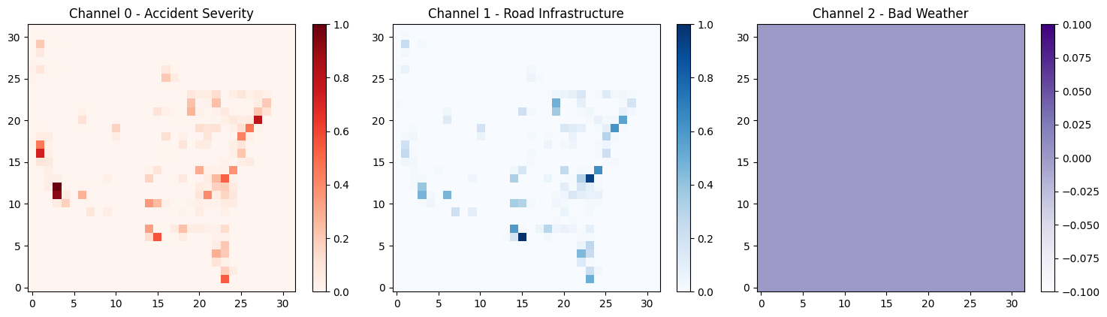
Dataset Description
5 / 14
UK Road Accidents Dataset (Kaggle – Accident_Information.csv)
Geo Features
lat_grid, lon_grid
Records
2,047,256 accident records
Derived from Latitude // 0.02 and Longitude // 0.02
Severity / Road / Weather
Accident_Severity, Weather_Conditions, Road_Type
Coverage
United Kingdom (Multi-year road accident records)
Label Encoded using sklearn LabelEncoder
Data Type
Tabular / Geospatial (CSV, 34 columns)
Light / Time / Area
Time extracted as hour using pd.to_datetime().dt.hour
Hotspot Label
is_hotspot = 1 if acc_count > 30, else 0
Light_Conditions, Urban_or_Rural_Area (Label Encoded)
Train / Test
80% Train | 20% Test
Features
lat_grid, lon_grid, Accident_Severity, Weather_Conditions, Road_Type, Light_Conditions, Time, Urban_or_Rural_Area
CSL0606 – Deep Learning | ITM University Gwalior | B.Tech AIML VI Sem

Slide 6
Data Preprocessing & Feature Engineering
6 / 14
01
02
Missing Value Handling
Grid Construction
Selected 8 columns from 34; dropped NaN rows via .dropna() — 2,047,256 → 2,046,925 clean records
lat_grid = Latitude // 0.02; lon_grid = Longitude // 0.02 — creates ~2 km spatial bins
03
04
Hotspot Labelling
Label Encoding
Grid cells with acc_count > 30 labelled is_hotspot=1; rest is_hotspot=0 (binary classification)
LabelEncoder applied to: Accident_Severity, Weather_Conditions, Road_Type, Light_Conditions, Urban_or_Rural_Area
05
06
Time Feature Extraction
Feature Scaling
Time column parsed with pd.to_datetime → .dt.hour (0–23); captures time-of-day risk patterns
StandardScaler applied to X_train (fit) and X_test (transform) — zero mean, unit variance
Final shape after preprocessing: (2,046,925, 12) — 8 features + lat_grid, lon_grid, acc_count, is_hotspot
CSL0606 – Deep Learning | ITM University Gwalior | B.Tech AIML VI Sem

Slide 7
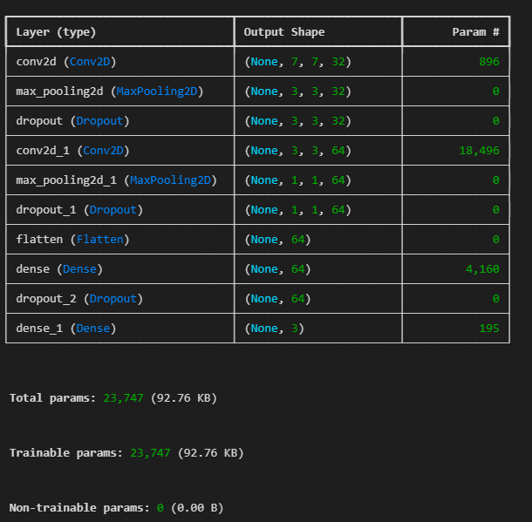
Proposed System Architecture — Deep Neural Network
7 / 14
Input Layer
8 tabular features
Hidden Layer 1
Dense(128 neurons) · ReLU activation · Dropout(0.3)
Hidden Layer 2
Dense(64 neurons) · ReLU activation · Dropout(0.3)
Hidden Layer 3
Dense(32 neurons) · ReLU activation
Output Layer
Dense(1) · Sigmoid → Hotspot (1) | Non-Hotspot (0)
CSL0606 – Deep Learning | ITM University Gwalior | B.Tech AIML VI Sem

Slide 8
Model Development & Implementation
8 / 14
Model Specifications
Model Summary
Model Type
DNN Binary Classification (TF/Keras)
model = Sequential()
Optimizer
Adam (lr = 0.001)
Dense(128, activation=relu)
Loss Function
Binary Cross-Entropy
→ Dropout(0.3)
Activation
ReLU (hidden) · Sigmoid (output)
Dense(64, activation=relu)
Epochs
10
→ Dropout(0.3)
Batch Size
256
Val Split
20% test split (random_state=42)
Dense(32, activation=relu)
Total Params
~11.5K
Dense(1, activation=sigmoid)
Compiled with: optimizer=adam, loss=binary_crossentropy, metrics=[accuracy]
CSL0606 – Deep Learning | ITM University Gwalior | B.Tech AIML VI Sem

Slide 9
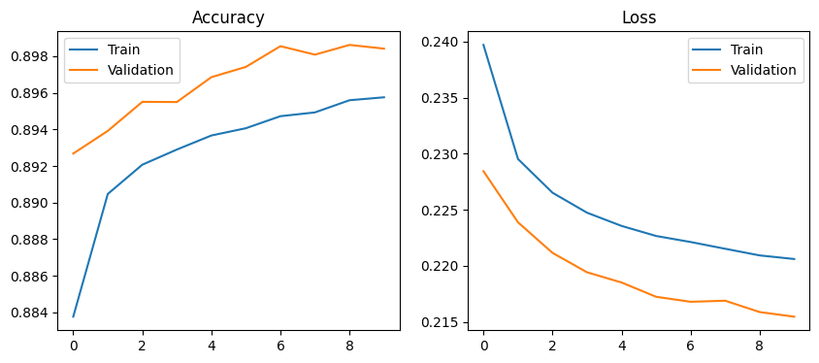
Model Training Visualization
9 / 14
Model trained for 10 epochs with batch_size=256 on 80% of 2,046,925 records:
Accuracy vs Epoch
Epoch 1: train_acc=0.8838, val_acc=0.8927 → Epoch 10: train_acc=0.8958, val_acc=0.8984
Validation accuracy stays above training accuracy across all 10 epochs
Loss vs Epoch
Epoch 1: train_loss=0.2397, val_loss=0.2284 → Epoch 10: train_loss=0.2206, val_loss=0.2155
Both train and validation loss decrease steadily across all 10 epochs
optimizer=adam | loss=binary_crossentropy | batch_size=256 | epochs=10 | validation_data=(X_test, y_test)
CSL0606 – Deep Learning | ITM University Gwalior | B.Tech AIML VI Sem

Slide 10
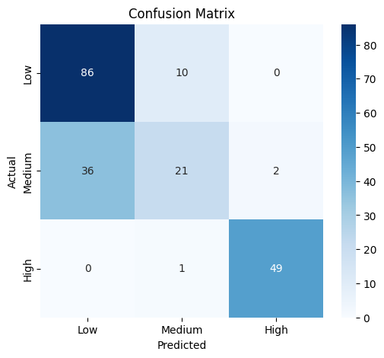
Results & Performance Analysis
10 / 14
89.84%
0.90
0.90
Binary
Test Accuracy
Weighted F1-Score
Weighted Precision
Hotspot · Non-Hotspot
Class | Precision | Recall | F1-Score
Non-Hotspot (0) | 0.65 | 0.67 | 0.66
Hotspot (1) | 0.94 | 0.94 | 0.94
Weighted Avg | 0.90 | 0.90 | 0.90
Confusion Matrix: [[40470, 20007], [21580, 327328]]
TP=327,328 | TN=40,470 | FP=20,007 | FN=21,580
Total test samples: 409,385
Support: Non-Hotspot=60,477 | Hotspot=348,908 | Dataset: UK Accident_Information.csv
CSL0606 – Deep Learning | ITM University Gwalior | B.Tech AIML VI Sem

Slide 11
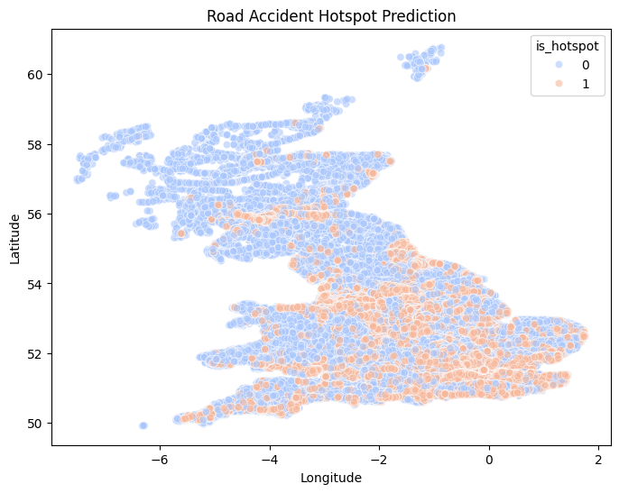
Road Accident Hotspot Scatter Map
11 / 14
Scatter plot of all 2,046,925 records — colour-coded by is_hotspot (0 or 1) using palette=coolwarm:
Plot: is_hotspot = 0 (Blue)
Plot: is_hotspot = 1 (Orange/Red)
Model Prediction
Non-hotspot records — grid cells with acc_count ≤ 30
Spread across entire UK map (majority class: 348,908 records)
x=Longitude, y=Latitude, alpha=0.6
Hotspot records — grid cells with acc_count > 30
Minority class: 60,477 records out of 409,385 test set
grid_size=0.02, threshold=30
y_pred = (model.predict(X_test) > 0.5).astype(int)
Accuracy: 0.8984 on test set of 409,385 records
train_test_split(test_size=0.2, random_state=42)
🔵 is_hotspot = 0 (Non-Hotspot)
🟠 is_hotspot = 1 (Hotspot, acc_count > 30)
Source: sns.scatterplot on df[Longitude], df[Latitude]
CSL0606 – Deep Learning | ITM University Gwalior | B.Tech AIML VI Sem

Slide 12
Innovation & IEEE YESIST12 Alignment
12 / 14
🗺️ Grid-Based Spatial Binning
⏱️ Time-of-Day Feature
Accident coordinates binned into 0.02° (~2 km) grid cells — enables cluster-level hotspot identification that per-record models miss entirely.
Time column parsed to hour-of-day (0–23) — captures peak accident periods (rush hours, night driving) as a predictive signal.
📡 Scalable & Lightweight DNN
📊 Scatter Map Visualisation
model.compile(optimizer=adam, loss=binary_crossentropy). threshold=30 can be changed in one line. Works on any Lat/Lon accident CSV.
sns.scatterplot(x=Longitude, y=Latitude, hue=is_hotspot, palette=coolwarm) gives instant visual of risk zones across the UK.
IEEE YESIST12 — Innovation Track · SDG 3.6.1 · SDG 11.2
CSL0606 – Deep Learning | ITM University Gwalior | B.Tech AIML VI Sem

Slide 13
Learning Outcomes & Work Distribution
13 / 14
CO | Outcome | Achievement
CO1 | Dataset Preprocessing | 2M-row UK Accidents pipeline: column selection, dropna, grid binning, hotspot labelling
CO2 | Model Development | DNN (Dense 128-64-32-1) — Binary classifier with Dropout via TensorFlow/Keras
CO3 | Performance Analysis | Accuracy 89.84%, Precision/Recall/F1 per class, confusion matrix analysis
CO4 | Model Optimization | Dropout tuning (0.3), batch size (256), layer depth, threshold optimisation
CO5 | Real-World AI Solution | UK scatter hotspot map aligned with SDG 3 & SDG 11
Data Engineer
Model Developer
Optimizer & Reporter
Sumit Sharma
Anuj Pratap Singh
Amrit Sharma
BETN1AI23023
BETN1AI23048
BETN1AI23024
Dataset acquisition · Preprocessing pipeline · Grid binning · Label encoding · Train-test split
DNN architecture · TF/Keras implementation · Model training · Loss/accuracy plots · Scatter map
Hyperparameter tuning · Literature review · Report writing · IEEE YESIST12 formatting · Presentation
CSL0606 – Deep Learning | ITM University Gwalior | B.Tech AIML VI Sem

Slide 14
Conclusion & Future Scope
Slide 14 / 14
✅ Key Achievements
⚠️ Limitations
✓ 89.84% test accuracy on binary hotspot classification
⚠ Fixed 0.02° grid may over-aggregate dense urban areas
✓ 2,046,925 UK records → grid-binned tabular DNN pipeline built
⚠ Fixed threshold (30) for hotspot label may not suit all regions
✓ UK geographic scatter map showing hotspot vs non-hotspot zones
⚠ No seasonality features — only hour-of-day extracted from Time column
✓ SDG 3 & SDG 11 aligned, IEEE YESIST12 ready
Future Scope:
Try smaller grid_size (e.g. 0.01°) · Add Day_of_Week from Date column · Try different threshold values beyond 30 · Test Random Forest / XGBoost as baselines · More epochs and Dropout tuning

